Slide 1


OF POST GRADUATE PROGRAM IN FULL STACK WEB DEVELOPMENT
PRESENTATION ON [ PROJECT -2 ] LEARNER ACADEMY (ONLINE LEARNING SYSTEM)
IN

Slide 2
Developer Details:
NAME : MUBASHIR P
POST GRADUATE PROGRAM IN FULL STACK WEB DEVELOPMENT (STUDENT)
IN

Slide 3
Introduction
In this system we present a smart question paper generating system for universities. It is made to allow universities to generate question papers with random but even questions to cover most chapters of a subject with difficulty level within seconds and mail them to colleges instantly. In our system we allow administrators to input a set of questions. We also allow admin to provide weight age and complexity for each of these questions. After this the questions are stored in a database along with their weight age. Now on question paper generating time the admin just has to select the percentage of difficulty. On this selection the system selects questions randomly in a way that their weightage makes up for 100 marks and according to difficulty that admin chooses the questions are chosen based on their complexity level. The questions are also added for various difficulty levels so that as soon as the admin chooses the type of paper difficulty (Easy, medium, difficult) the system automatically generates paper, prepares a doc file as per selected paper format. Also emails it to other colleges. After this question paper is converted to a pdf file and emailed to colleges on button click.

Slide 4
Technologies
JSP And SERVLET
HTML : Page layout has been designed in HTML
CSS : CSS has been used for all the designing part
JavaScript : All the validation task and animations has been developed by JavaScript
Java : All the business logic has been written in Java
MySQL : MySQL database has been used as database for the project

Slide 5
Software configuration
Operating system : MACBOOK AIR M2
Environment : Spring Tool Suite (IDE)
SERVER : apache tomcat-8.5
Technologies : JAVA, HTML, JSP AND SERVLET, CSS ,
JAVA SCRIPT, MY SQL

Slide 6
WHAT IS SERVLET..?
A Servlet is a Java program that runs on a web server to handle HTTP requests and generate dynamic web content. It is a server-side technology that provides a platform-neutral way of building web-based applications in Java.
Servlets are used to extend the functionality of web servers by handling client requests and generating dynamic responses. They provide a powerful and efficient way to build web applications that can handle a large number of requests concurrently.
Servlets receive requests from clients, process the requests, and generate dynamic HTML content to send back to the client. They can handle a variety of request types, including GET, POST, PUT, and DELETE.
Servlets are commonly used in combination with JavaServer Pages (JSP) and JavaBeans to create robust and scalable web applications. They are part of the Java EE (Enterprise Edition) specification and are supported by most web servers and application servers.

Slide 7
WHAT IS JSP..?
JSP stands for JavaServer Pages, which is a technology used for creating dynamic web pages in Java. It is a server-side programming language that allows developers to create web pages by embedding Java code into HTML pages.
JSP pages are first compiled into Java servlets, which are then executed by the web server to generate dynamic content. JSP provides a framework for developing web applications that can access databases, interact with users, and process data.
JSP technology is often used in combination with Java Servlets and JavaBeans to create robust and scalable web applications. It is a popular choice for creating web applications in Java because it provides a simple and easy-to-learn syntax, and it is compatible with most web servers and application servers.

Slide 8
Modules
Functionality performed by Admin user:
These are the functionality performed by the admin users.
MODULE-{ 1 } Login for Admin
Forgot password for Admin
Edit Profile for Admin
Change Password for Admin
Logout Functionality
Dashboard for Admin User

Slide 9
MODULE- { 2 } Manage Branch
Adding New Branch
Edit the Existing Branch
View details of the Branch
Listing of all Branch
MODULE- { 3 } Manage Course
Adding New Course
Edit the Existing Course
View details of the Course
Listing of all Course

Slide 10
MODULE- { 4 } Manage Question
Adding New Question
Edit the Existing Question
View details of the Question
Listing of all Question
MODULE- { 5 } Manage Subject
Adding New Subject
Edit the Existing Subject
View details of the Subject
Listing of all Subject

Slide 11
MODULE- { 5 } Manage System User
Adding New System User
Edit the Existing System User
View details of the System User
Listing of all System User
MODULE- { 6 } Functionality performed by Teachers
:
Creating Question papers
Editing Questions.
Emailing it to other users

Slide 12
ALGORITHM:
STEP 1 : START
STEP 2 : Define the basic requirements for the online learning system. This includes determining the features and functionalities that the system must have to meet the needs of the users.
STEP 3 : Design the user interface for the system. This includes creating mock-ups of the different screens and pages that the user will interact with.
STEP 4 : Create a database schema that will be used to store user data and course information. This will involve defining the different tables, columns, and relationships that will be needed.
STEP 5 : Set up a web server and install the necessary software (e.g., Java, Tomcat) to support JSP and Servlet development.
STEP 6 : Create a Java class that will handle user authentication. This class should verify the user's credentials (e.g., username and password) against the data stored in the database.

Slide 13
STEP 7 : Build the main servlet that will handle user requests and responses. This servlet should use the Java authentication class to ensure that the user is authorized to access the requested resources.
STEP 8 : Develop JSP pages that will display course information to the user. This will include creating a page that lists all available courses, as well as individual pages for each course that provide more detailed information.
STEP 9 : Implement a system for enrolling in courses. This should allow users to select the courses they want to take and register for them.
STEP 10 : Develop a feature that allows users to track their progress through the course. This could include displaying completed assignments or quizzes, as well as providing access to course materials such as lectures and videos.
STEP 11 : Implement a system for handling payments, if the online learning system charges users for access to courses
STEP 12 : Build an administrative interface that allows authorized users to manage course content, update user data, and perform other administrative tasks.
STEP 13 : Test the system to ensure that it is functioning correctly and that all user requirements are met. This may involve testing individual components and features, as well as testing the system as a whole.
STEP 14 : Deploy the system to a production environment and monitor its performance to ensure that it is scalable and can handle a large number of users.
STEP 15 : Continuously monitor and update the system to fix bugs, add new features, and improve performance based on user feedback and usage data.
STEP 16 : STOP

Slide 14
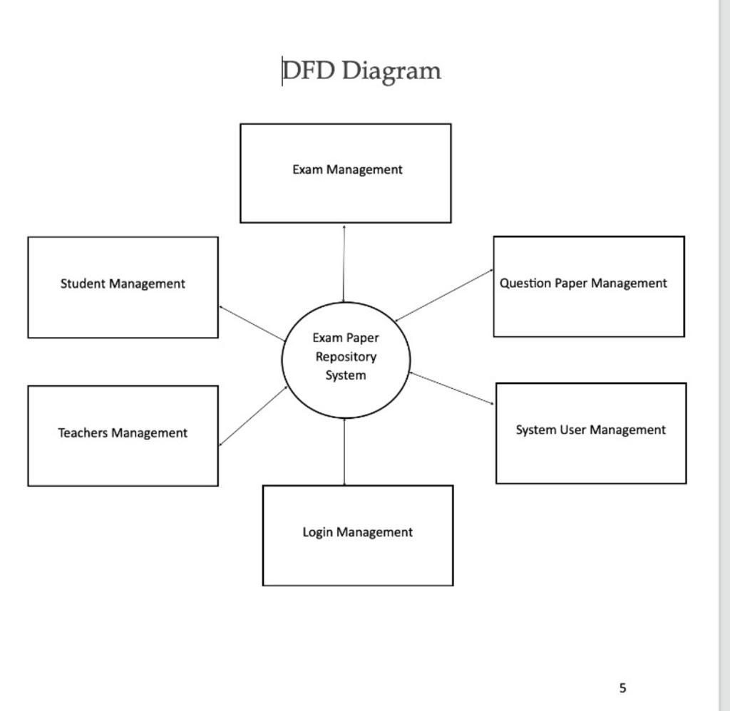

Slide 15
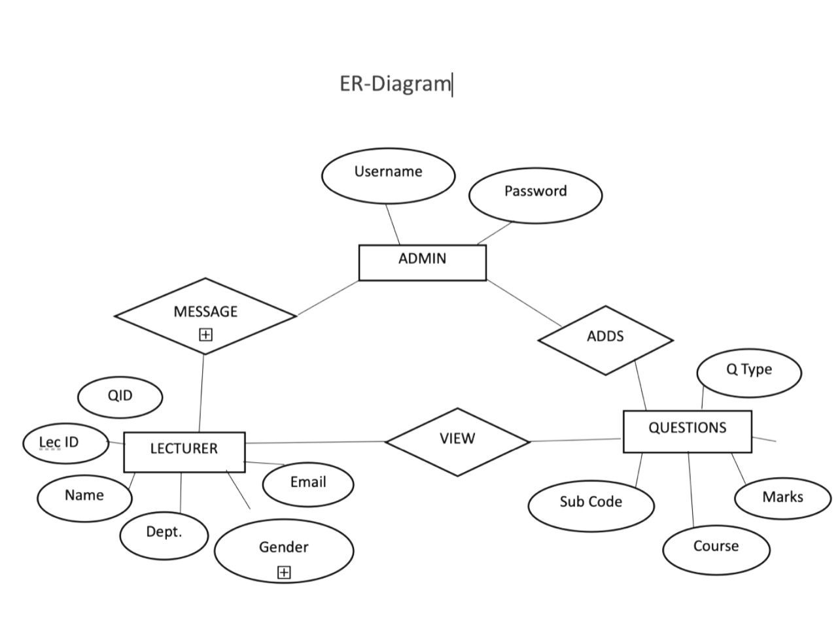

Slide 16
Sprints Plan And The Tasks Achievement Details
Sprint no | Task Planned | Start Date | End Date | Detailed Action | Status
1 | ANALYSIS [5 DAYS] | 21/FEB/2023 | 26/FEB/2023 | 21/FEB/2023 STARTED DOING ANALYSIS OF THE PROJECT
2 | WRITING CODE [5 DAYS] | 26/FEB/2023 | 03/MARCH/23 | 26/FEB/2023 STARTED DOING WRITING CODE OF THE PROJECT
3 | TESING [3 DAYS] | 03/MAR/2023 | 06/MARCH/2023 | 03/MAR/2023 STARTED DOING TESTING OF THE PROJECT
4 | DOCUMENTATION [2 DAYS] | 06/MAR/2023 | 08/MAR/2023 | 06/MAR/2023 DOCUMENTATION OF THE PROJECT
TOTAL NUMBER OF DAYS | 15 DAYS

Slide 17
CONCLUSION:
In conclusion, an online learning system using JSP and Servlet technology can be a valuable tool for both students and educators. This system provides a user-friendly interface for students to access course materials, track their progress, and interact with other students and instructors through a forum.
The system allows for flexibility in terms of course selection and completion, as users can choose courses at their own pace and access course content from anywhere with an internet connection.
Additionally, the system provides administrators with tools to manage user accounts, courses, and forums, ensuring the security and integrity of the system.
Overall, an online learning system using JSP and Servlet technology can revolutionize the way students learn and educators teach, providing an interactive, personalized learning experience that can benefit individuals and organizations alike.

Slide 18


